Slide 1

How to Request VA Letters and
DD 214

Slide 2
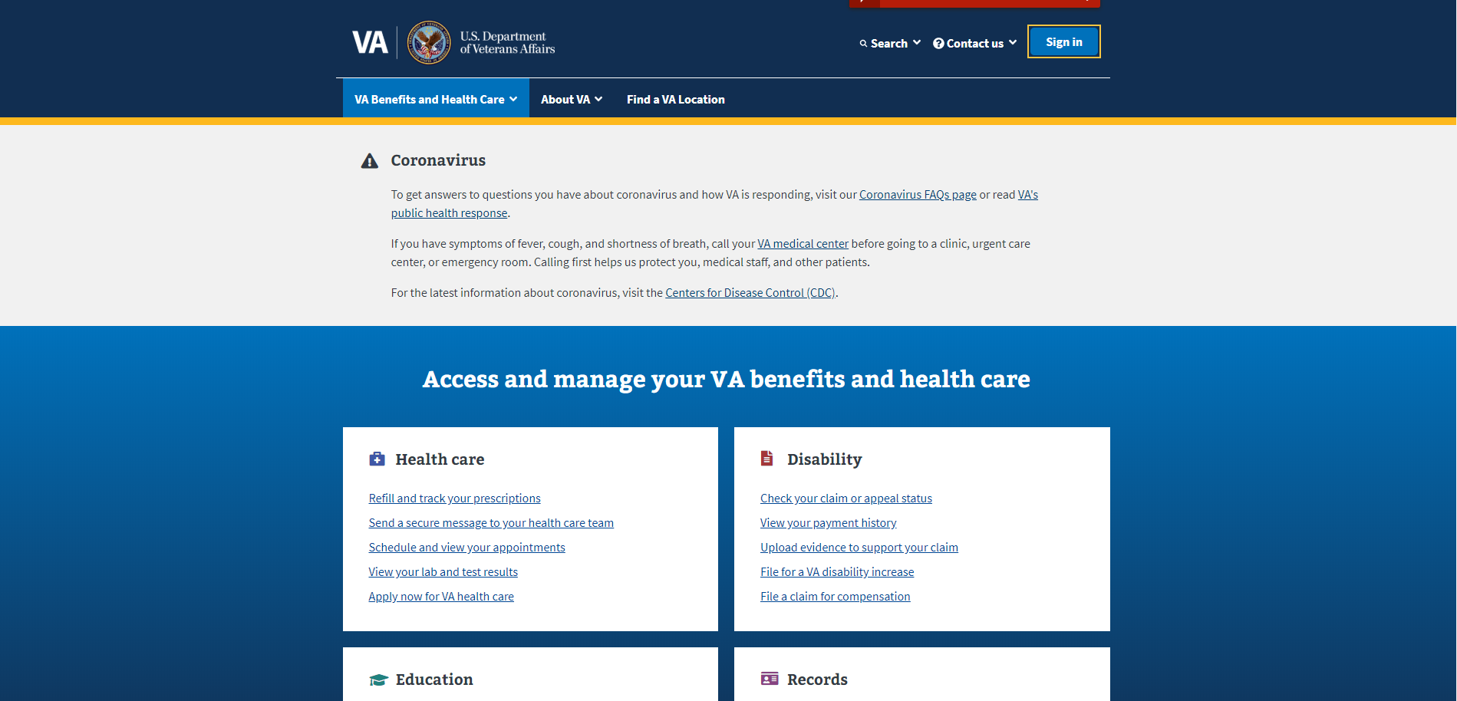
Log Into Your Premium Account Using DS Login
In your browser, type “va.gov” and it will take you to the site shown below
Select “Sign in” to begin

Slide 3
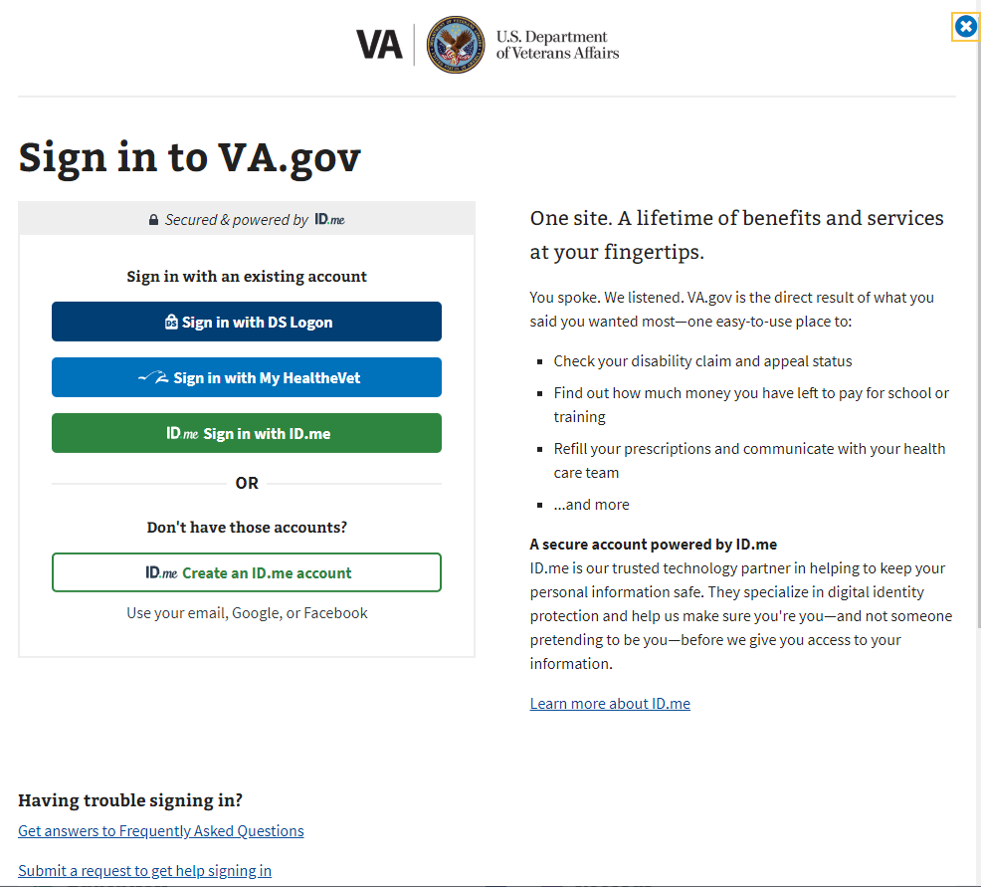
Log Into Your Premium Account Using DS Login
Select DS Login to sign in
If you use ID.me to sign in

Slide 4
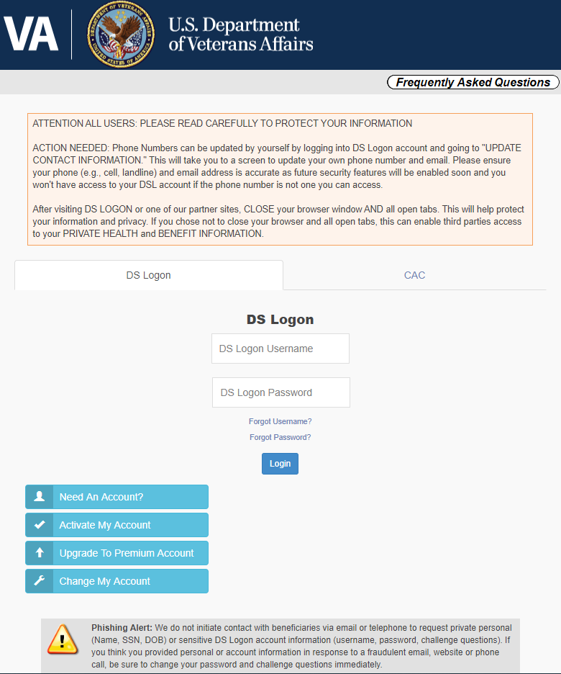
Log Into Your Premium Account Using DS Login
Enter username
Enter password
If you don’t have a DS Login select this option and register for DS Login
If you don’t have a premium account, select this option

Slide 5
How to Request VA Award Letter
Once You Have Signed In

Slide 6
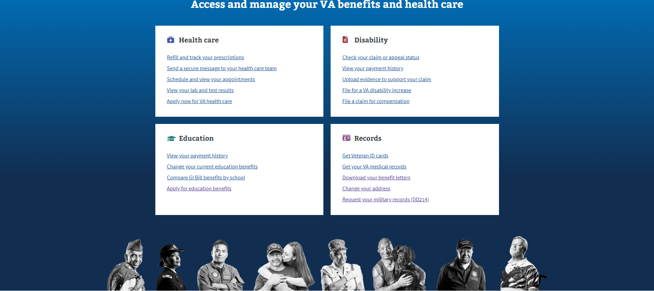
Request VA Award Letter
Select “Download your benefits letters”

Slide 7
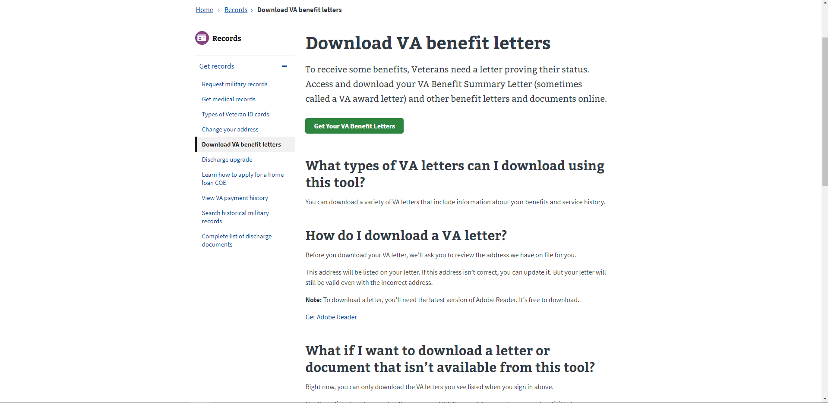
Request VA Award Letter
Click on “Get Your VA Benefit Letters”

Slide 8
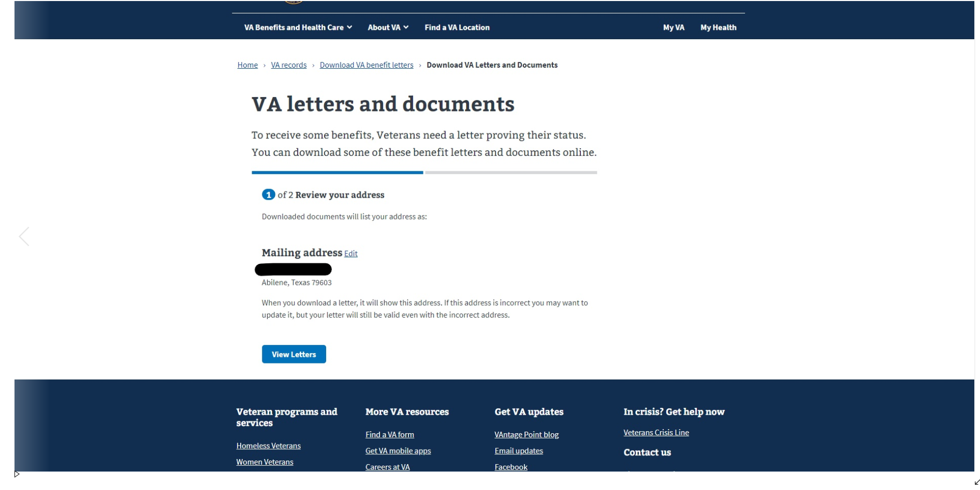
Request VA Award Letter
Verify your address is correct so your letter will be mailed every year
Once address is up to date, click “View Letters”

Slide 9
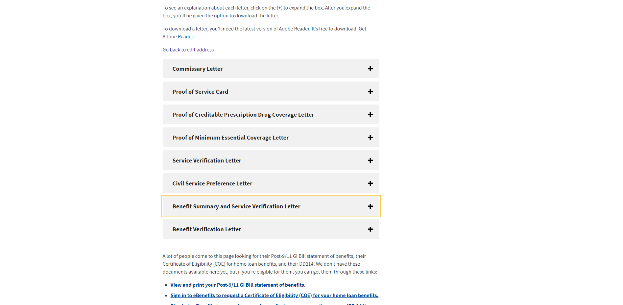
Request VA Award Letter
Select this box for Award Letter
You can also use this menu to print out your commissary letter (if you are Totally Disabled) and Civil Service Preference Letter

Slide 10
How to Request DD 214
Once You Have Signed In

Slide 11
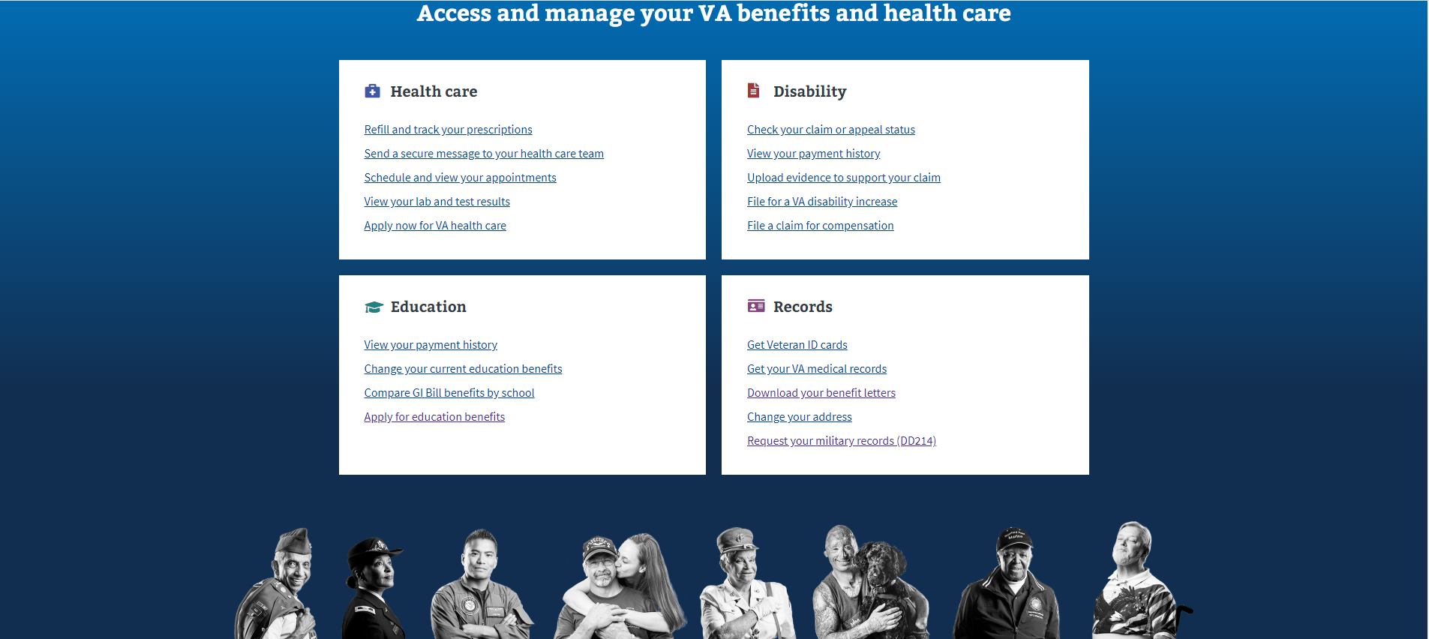
Request DD 214
Select “Request your military records (DD 214)”

Slide 12
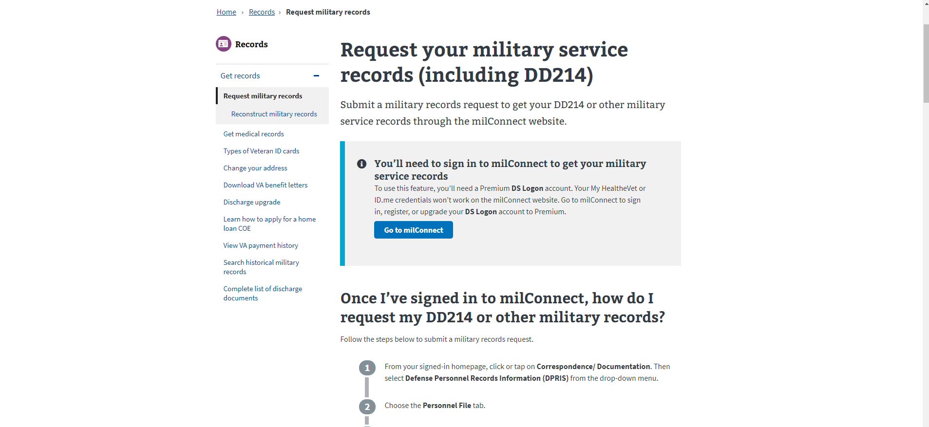
Request DD 214
Click “Go to milConnect”

Slide 13
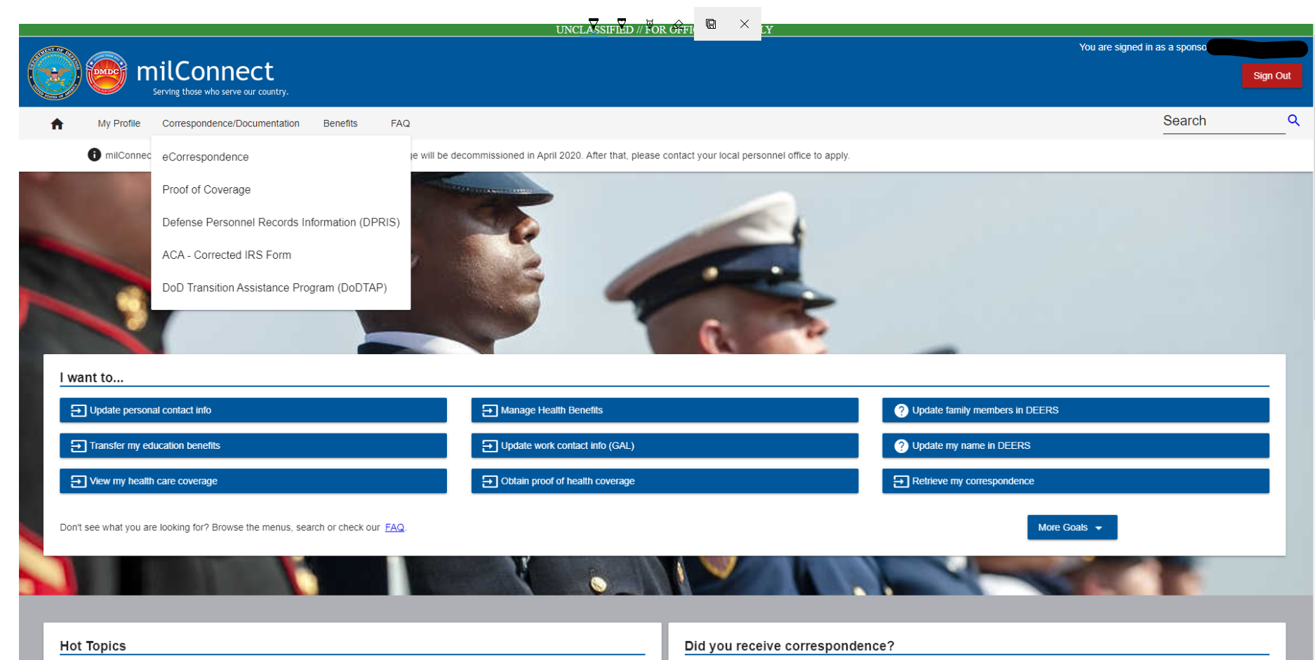
Request DD 214
First Click “Correspondence/Documentation”
Next, Select “Defense Personnel Records Information (DPRIS)”
from dropdown menu

Slide 14
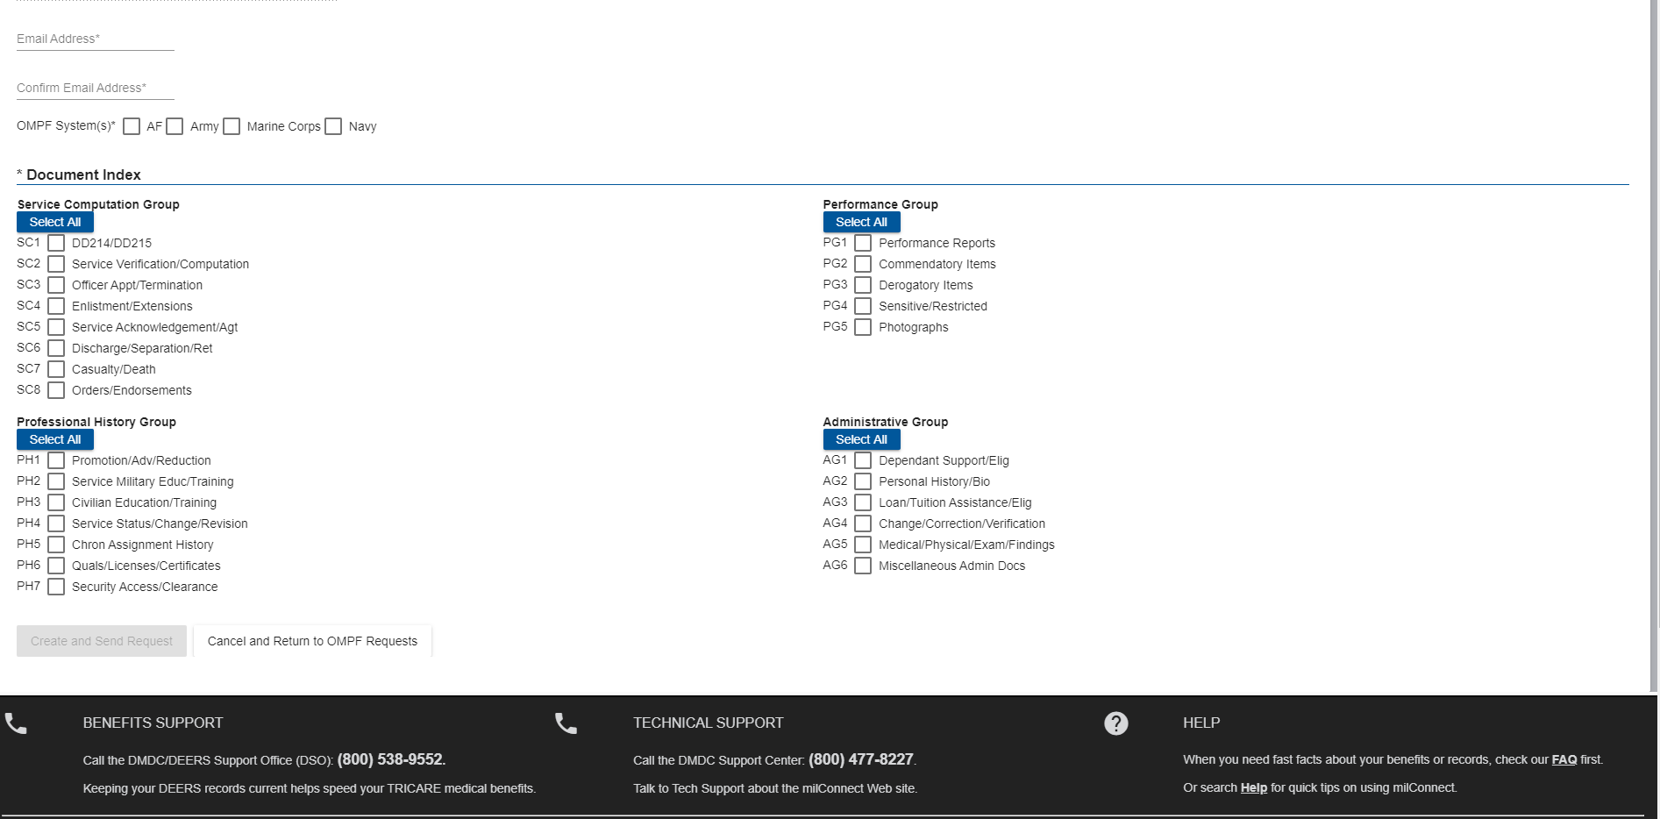
Request DD 214
Your Name and SSN will appear above this information
Enter a valid email
Confirm email
Check your branch of service
Check the box for DD 214
Once you select DD 214/DD 215 this box will allow you to submit request

Slide 15
Request DD 214
After request is submitted, you can repeat all previous steps to view status of request
Most requests can take 8-48 hours, depending on your date of separation from service
First Click “Correspondence/Documentation”
Next, Select “Defense Personnel Records Information (DPRIS)”
from dropdown menu

Slide 16
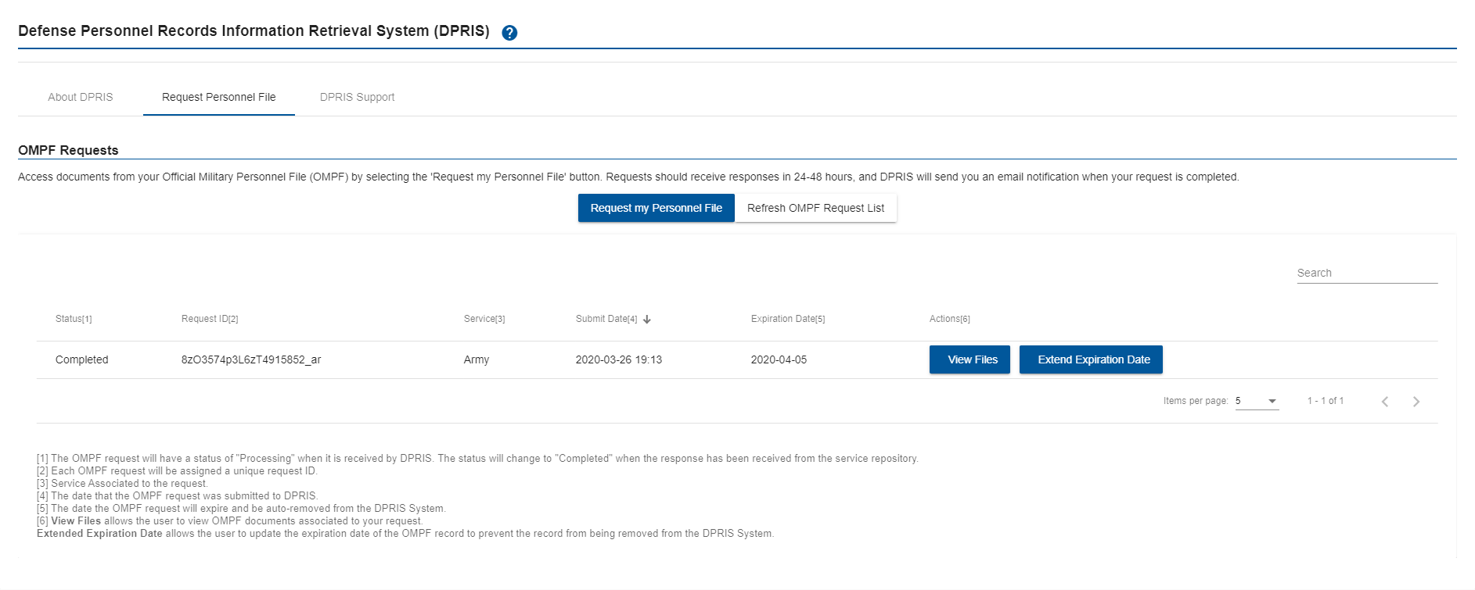
Request DD 214
Select “Request Personnel File”
View Files to download your DD 214

